Slide 1
Curriculum Night
2010-2011
Grade 5
Mrs. Bradford, Miss Kestel, Mrs. Wilds

Slide 2

Classroom Rules
Respect yourself, others, and things.
Contribute to the learning environment.
Follow classroom procedures.
Checkmark Chart

Slide 3

Discipline with Purpose
We will be incorporating the DWP skills into our everyday lives.
We will be completing activities and lessons using the 15 self-discipline skills.
Students will be recognized for using these skills throughout the year.

Slide 4
Language Arts
MacMillan/McGraw-Hill (Treasures)
  Story elements
  Guided Reading
  Fluency
  Skills
  Comprehension
  Spelling (Challenge Lists)
Book Projects
  Monthly
  Different Genres
  Novel Sets
    Hatchet
    The Lion, the Witch and the Wardrobe
    The Great Gilly Hopkins
    Island of the Blue Dolphins
    Flush
    AND MORE!

Slide 5

Language Arts
Grammar Workshop
  Supplement to Reading series
  Different Lessons and topics each week
Vocabulary Workshop
  Supplement to Reading series
  Test Every other week

Slide 6
Math
Houghton Mifflin Mathematics
  Addition, subtraction, multiplication, and division of whole numbers, fractions, and decimals
  Fractions (add, subtract, multiply, divide, compare, order, lowest terms, and equivalent)
  Long division (by 2 digit divisor)
  Converting measurements (customary and standard)
  Problem Solving Skills and Strategies
  Geometry
  Place Value
  Mad Minutes

Slide 7
Science
Houghton Mifflin Discovery Works
  Simple Machines
  Characteristics of Living Things
  Habitats and Biomes
  Physical Science
  Properties of Matter

Slide 8
Science
Frequent Labs
Study Guides
Projects
Group work
Science notebook
Unit tests
Smart Board

Slide 9


Religion
Harcourt Religion Series
Call to Faith
  Sacraments and Sacrament Game Show
  Incarnation
  Signs of Hope
  Liturgy
  Fr. Chi visits
  Monthly Prayer Quiz
Benziger Family Life
  Human Reproduction
  Puberty
  Sacrament of Marriage
  All life is sacred

Slide 10
Social Studies
Harcourt Horizons U.S. History (2010 copyright)
  Geography and Map skills (Political, physical, elevation maps)
  States and Capitals (throughout the year)
  Native Americans
  Explorers
  13 Colonies
  American Revolution
  The Great State Race

Slide 11
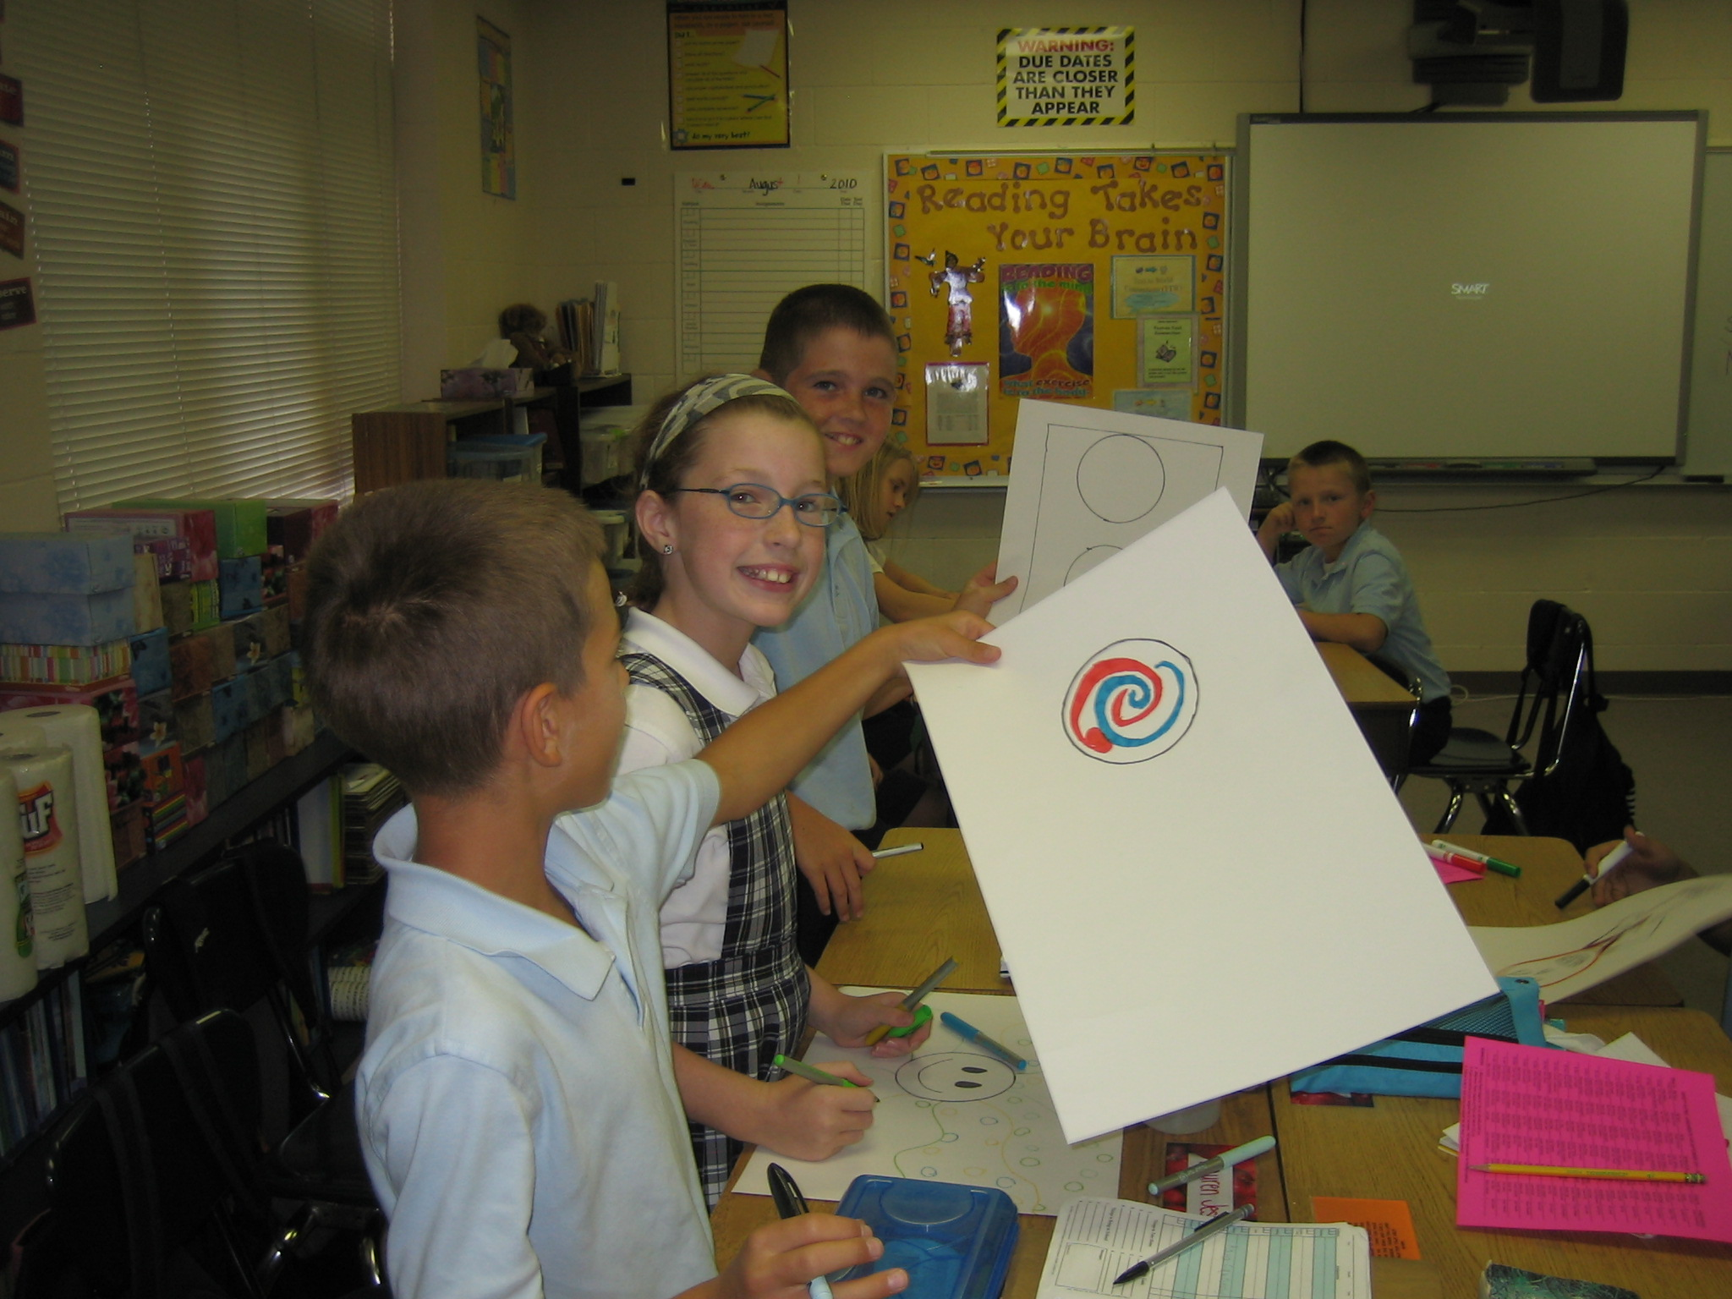
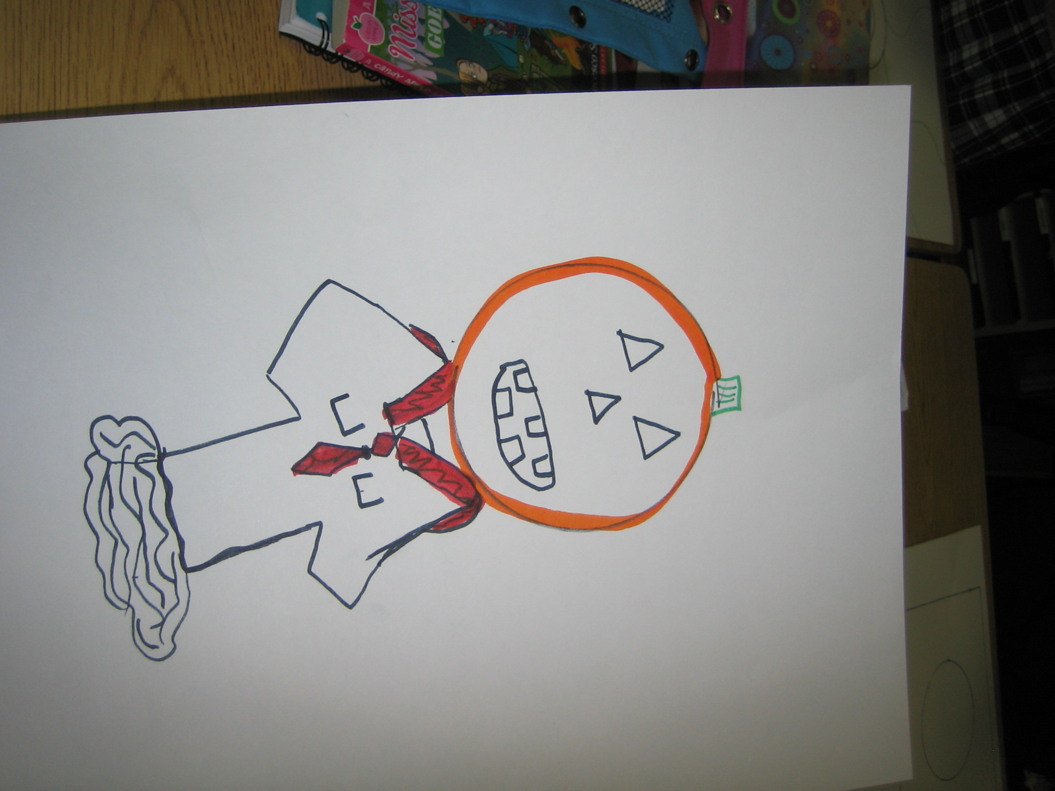

Art
We will be learning about a variety of art vocabulary, techniques, and masterpiece artists throughout the year.

Slide 12

Fantastic
Fifth Grade!
We look forward to having a very productive and positive year.
We hope that your student(s) will have a fun and successful year.
We are available through e-mails, notes, or phone. Feel free to contact us for ANYTHING!!!

Slide 13
Contacts
E-mail and Websites
  e.bradford@stephen.org
  http://mrsbradford5a.yolasite.com/
  m.kestel@stephen.org
  http://misskestel.synthasite.com/
  j.wilds@stephen.org
  http://mrswilds.synthasite.com/
  School phone number
  896-0754
School Website: www.stephen.org

